Slide 1

Starling Medical Showcase
Ibrahim Al-Akash

Slide 2
Anchor Redesign
Magnetic Attachment Mechanism

Slide 3
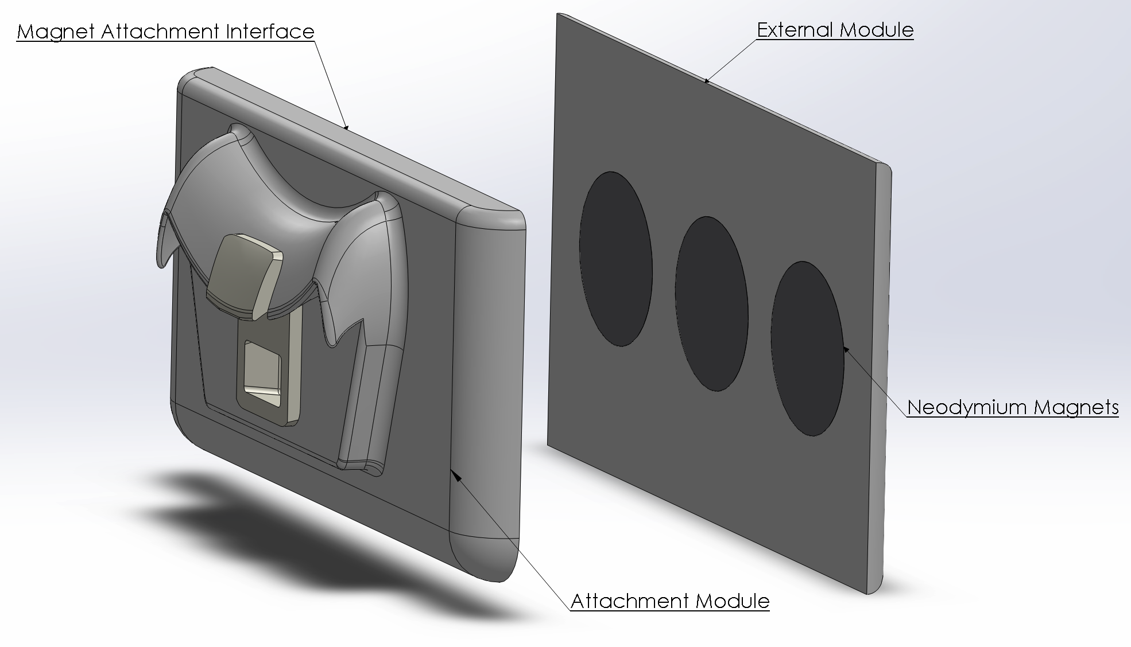
Magnetic Attachment Design
Item | Unit Cost
Magnets | $5.70
VytaFlex 30 (Soft Casing) | $8.58
Task 21 (Connector) | $0.27
Total | $14.55

Slide 4
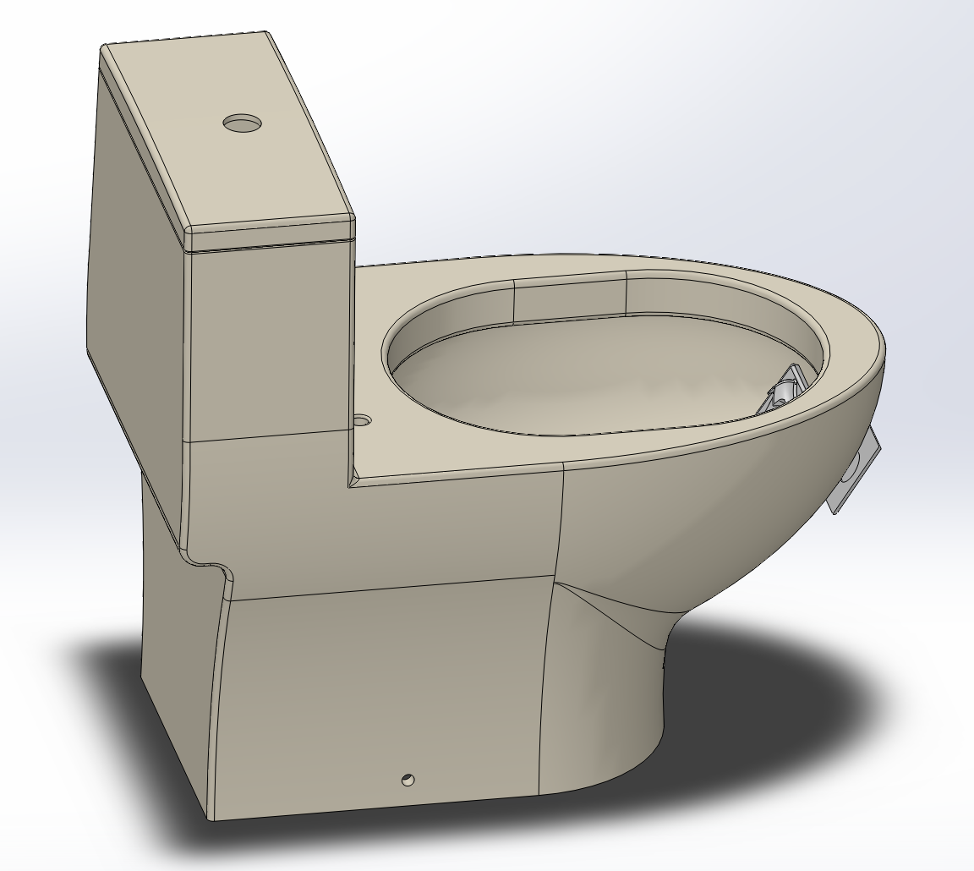
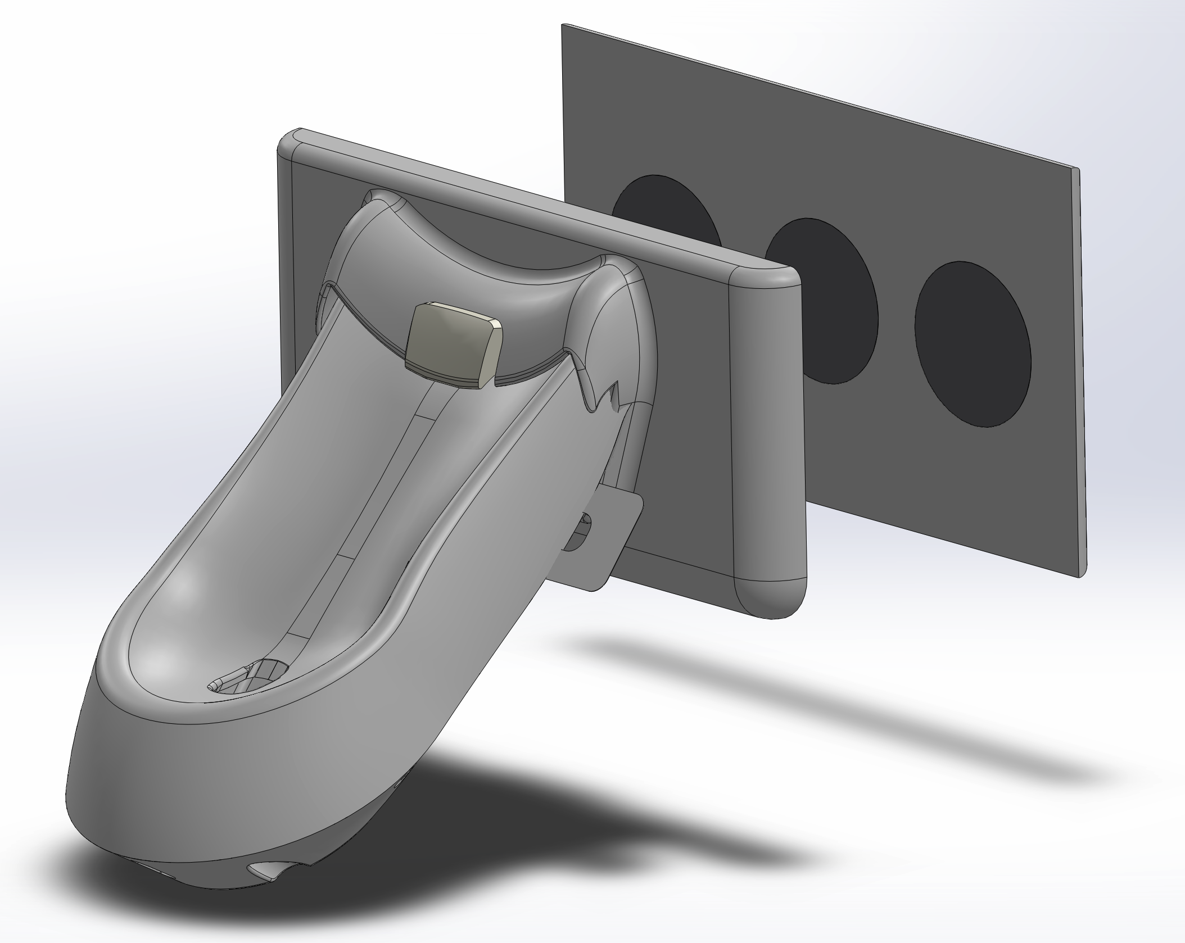
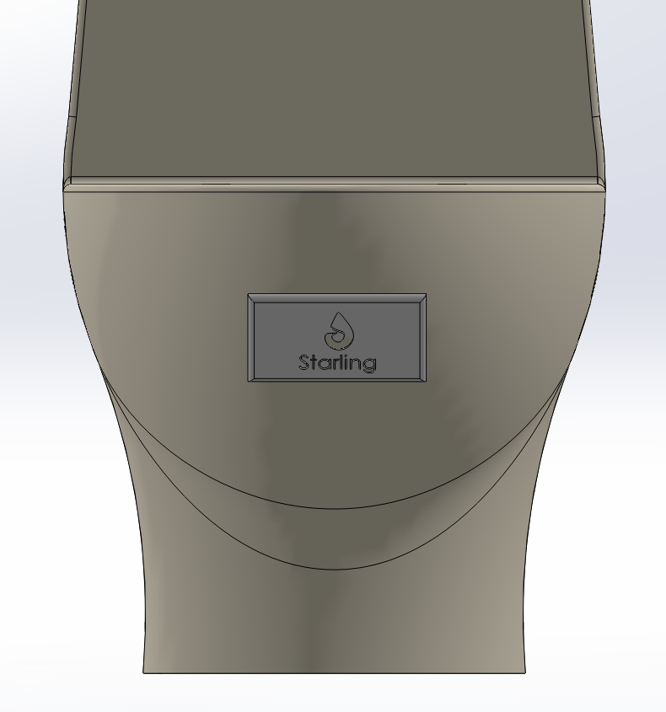
Magnetic Attachment Design

Slide 5
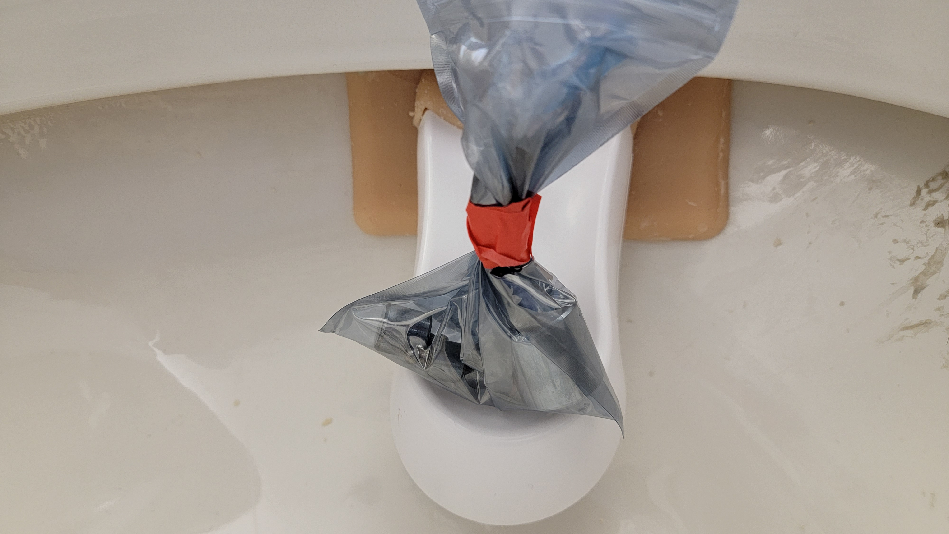
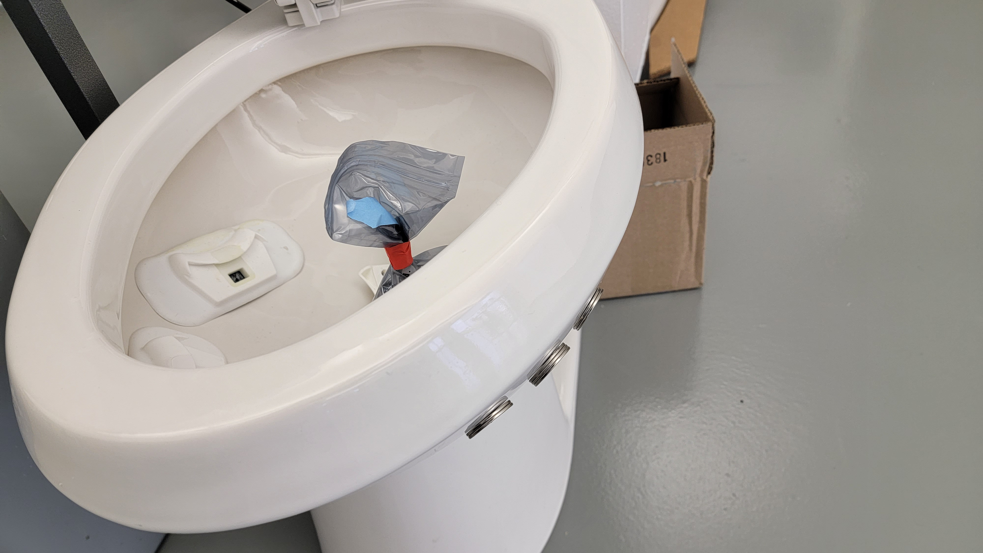
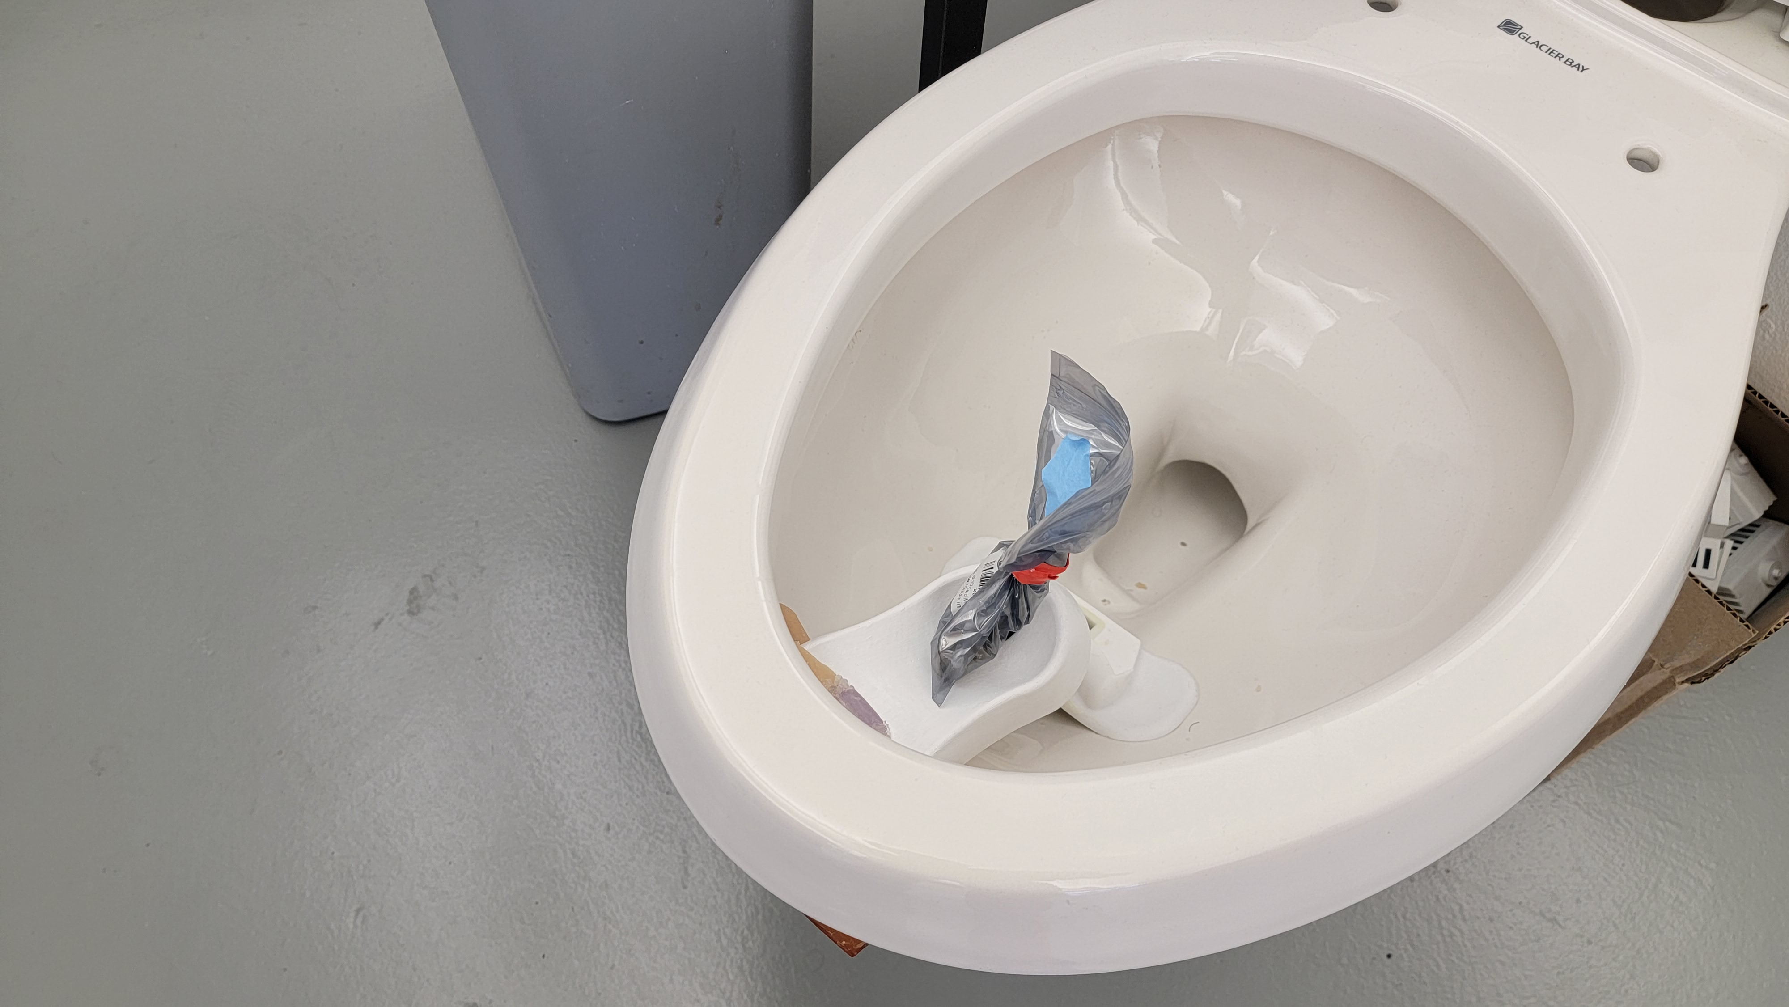
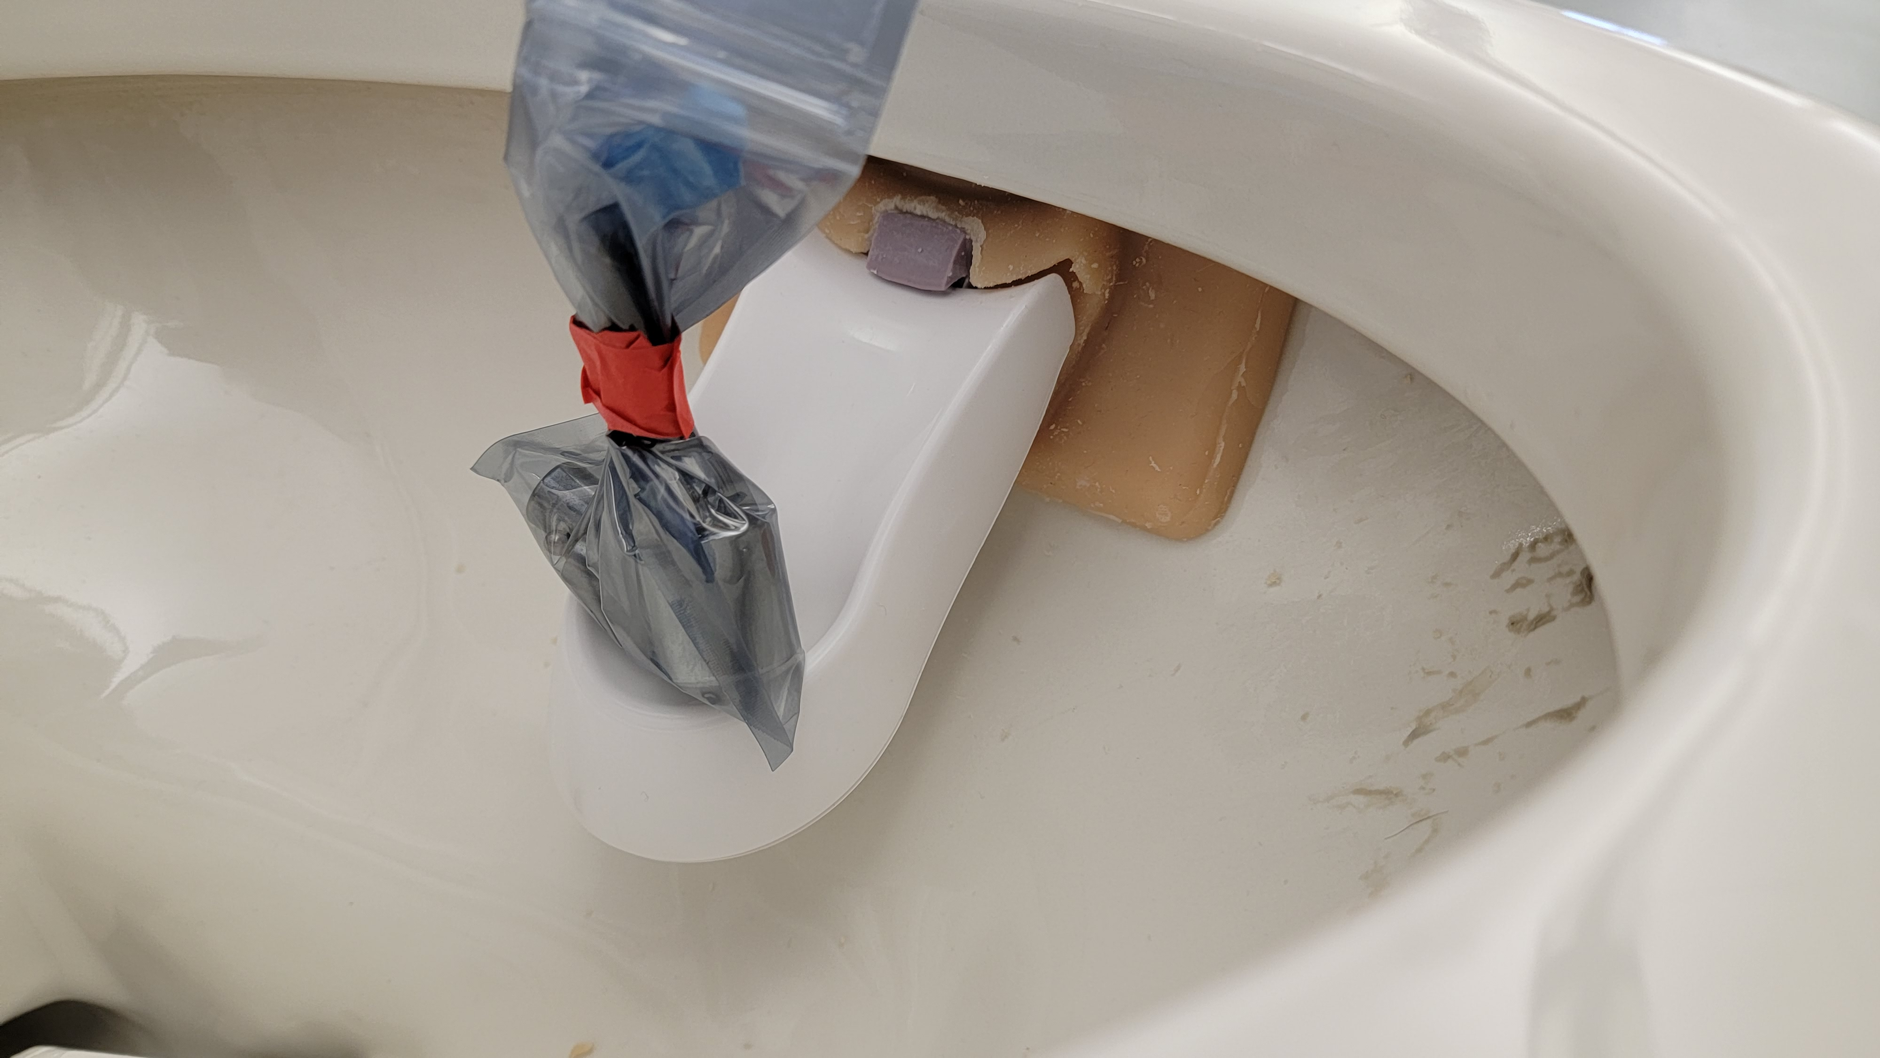
Testing

Slide 6
Testing
The magnetic attachment design passed the initial testing. The anchor was able to hold the UrinDX with a 155g lead weight for a period of 72 hours before failing
The point of failure in this test was the center magnet tore off and the plastic attachment interface disconnected
Previous iterations had failed due to the plastic attachment falling off as a result of the adhesives not sticking to the silicone backplate

Slide 7
Conclusions
I noticed a weak point during testing of the anchor was the inflexibility of the center section at high curvature in the bowl
To address this issue, I am making a new iteration with a softer silicone to enable easy forming to the bowl curve
Additionally, I hypothesize using bar magnets oriented vertically to help the silicone conform better to the bowl curve instead of the circular disc magnets currently used

Slide 8
BPH Sensor
Magnetometer Sensor

Slide 9
Introduction
The differential pressure sensor has shown promise, however 2 main issues
High cost compared to other sensor techniques ($40/sensor)
Potential issues down the line with sedimentation or corrosion
Magnetometer-based force sensor solves these issues
Low cost ($1.85/sensor)
No sedimentation issues
Ultra-low power consumption (100uW to 10mW)
High resolution (1 mN == equivalent to 0.1 g mass)

Slide 10
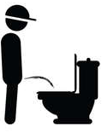
Magnetic Pressure Sensor
Urine Stream
Neodymium Magnet
F_{x}
Silicon Elastomer
F_{z}
F_{y}
Neodymium Magnet
Deformation
d₁
Silicon Elastomer
d₂
Magnetometer
Magnetometer
Force from urine stream causes shear and normal stress on elastomer, bringing the magnet closer/farther from the magnetometer. Magnetic field changes then corresponds to applied force

Slide 11
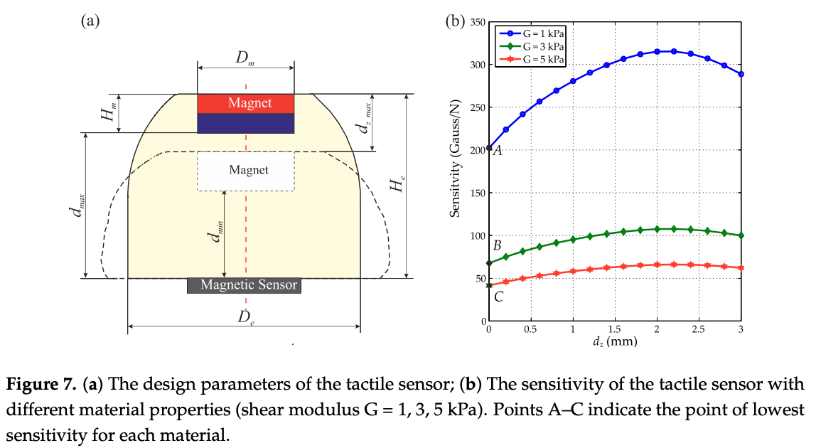

Slide 12
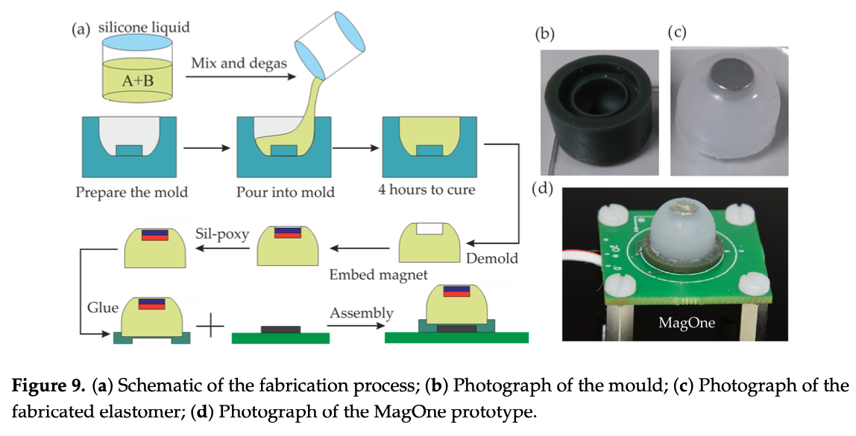
Manufacturing Process
3D Print Mold for Elastomer
Pour Elastomer (Si) into Mold and Cure
Attach the neodymium magnet to the indentation in the elastomer mold using Sil-poxy
Connect assembly to PCB using adhesives

Slide 13
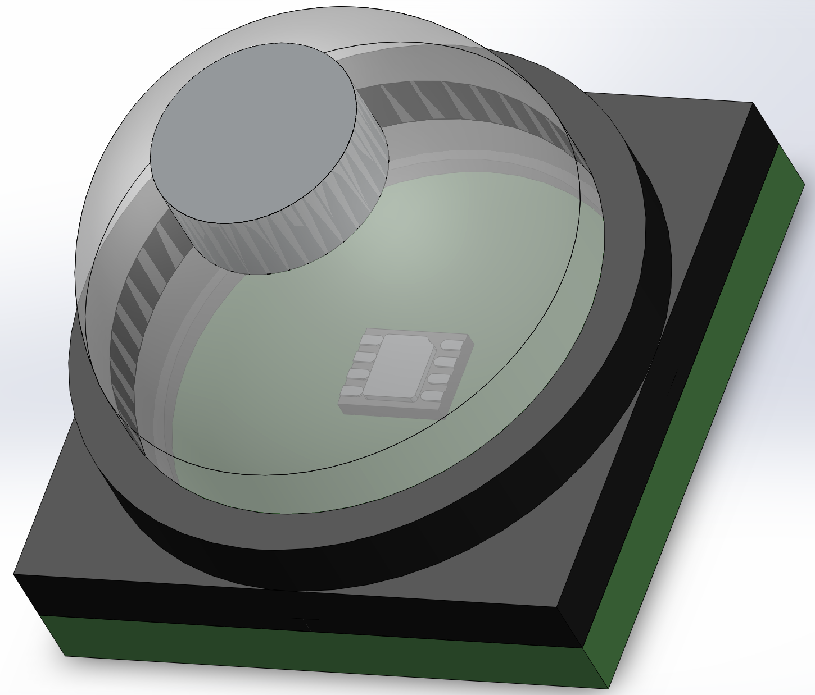
CAD Model
Neodymium Magnet
Silicon Elastomer
PCB Waterproof Casing
11.22mm
Magnetometer Sensor
PCB
14mm
14mm

Slide 14
Further Considerations
May be difficult to manufacture, since elastomer must be prepared manually
Elastomer can deform over time due to creep effects, however the geometry of the elastomer and placement of the magnet at the top mitigates this
Lots of testing required and many different configurations (ie. Elastomer material, elastomer geometry, magnet size, magnetometer)
Tilting of magnet can cause inaccuracies – can be mitigated with IMU MEMS sensor

Slide 15
Prototype Materials
Item | Cost
Neodymium Magnets (5mm x 2mm) | $6.99
Magnetometer | $1.85
Microcontroller | Available in lab
Silicon | $42.99 (2lbs)
Sil-poxy | $5.98
Silicon Releasing Agent | $16.99
3D-print | Available in lab
Total Cost of Materials: $74.80

Slide 16
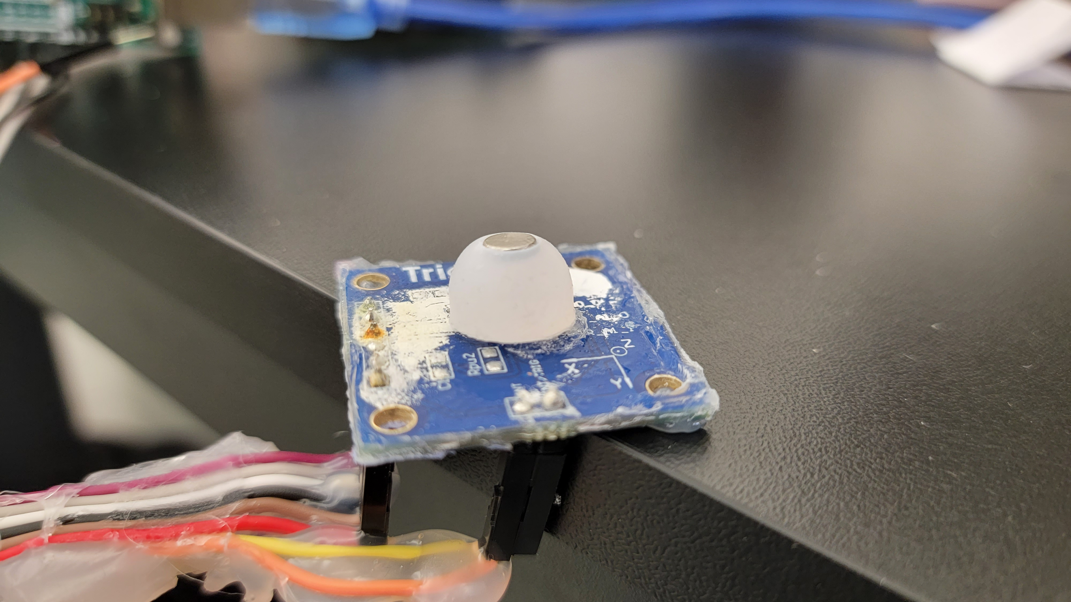
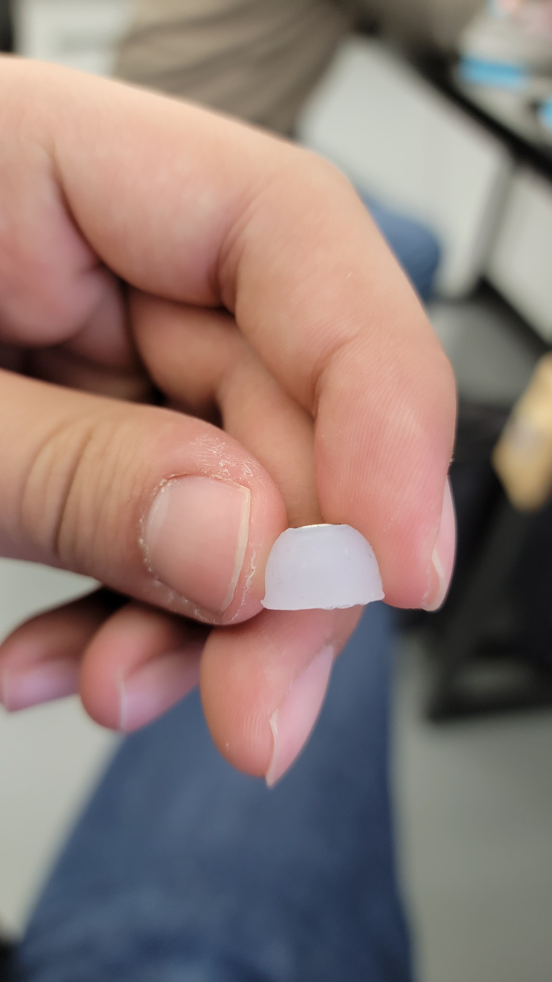
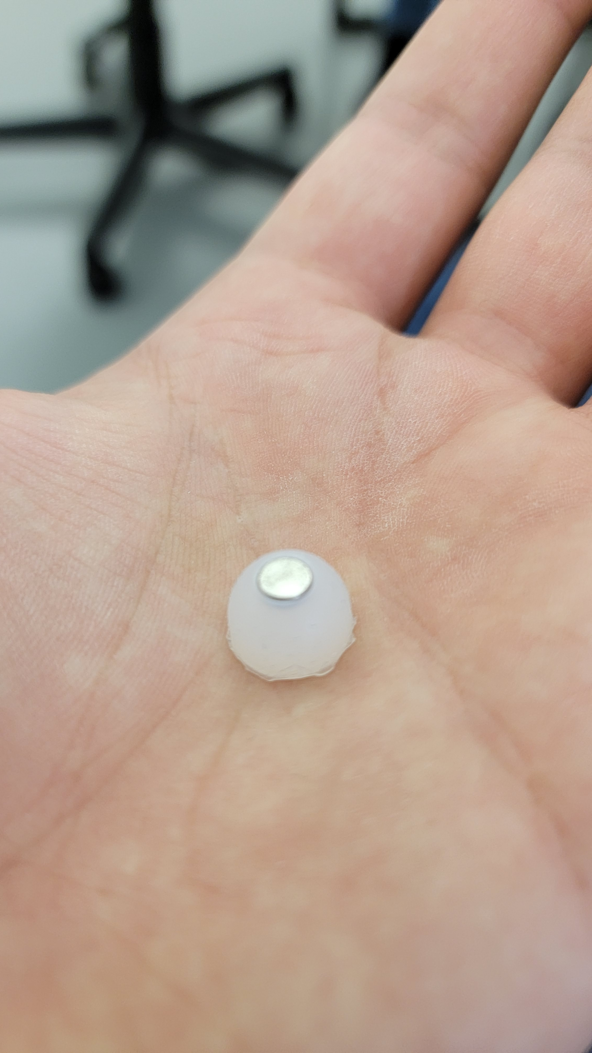
Finished Prototype

Slide 17
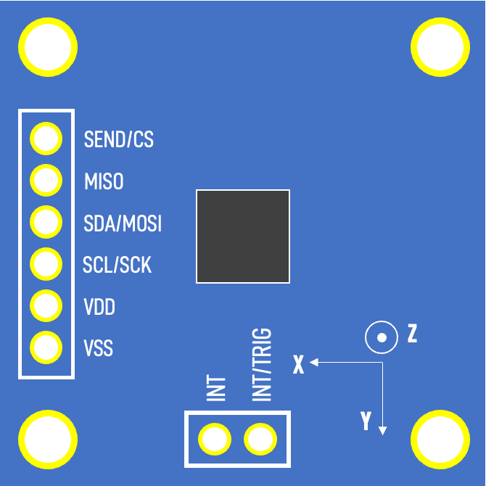
Sensor Pinout
FRONT
BACK
SEND/CS
MISO
30mm
SDA/MOSI
SCL/SCK
VDD
Z
VSS
INT/TRIG
INT
X
Y
30mm

Slide 18
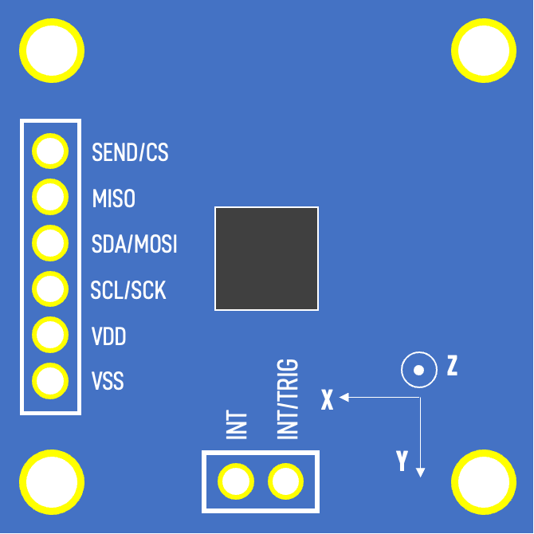
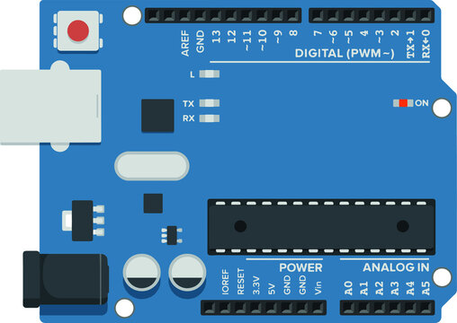
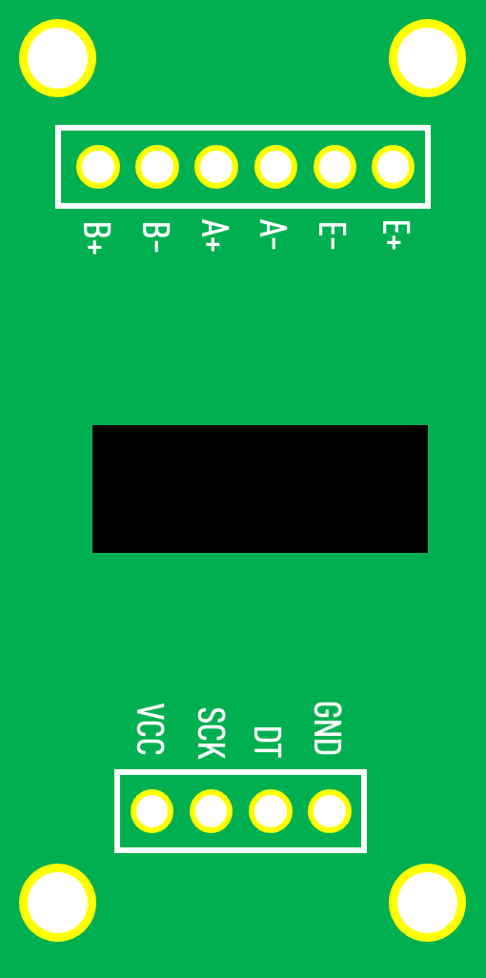
Circuit Schematic
3.3V
A5
HX711 Load Cell
0.1µF
A4
GND
10kΩ
MLX90393
Magnetometer
10kΩ
~D3
D2
GND
5V

Slide 19
Prototyping Phase 1
Static Water Testing

Slide 20
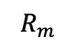
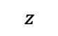
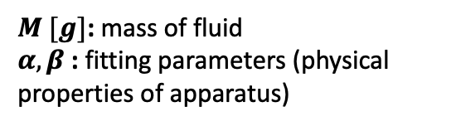

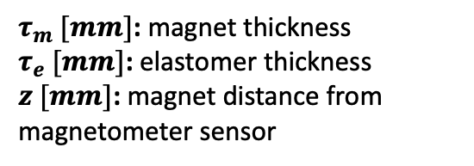
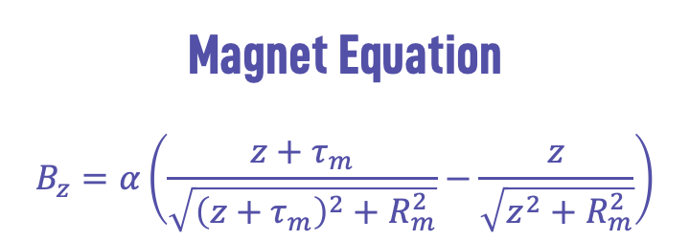
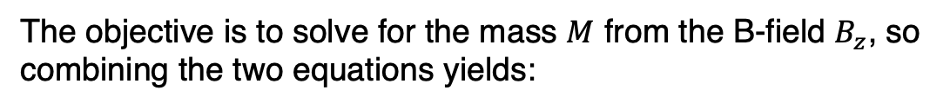
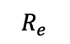
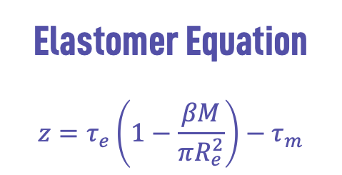
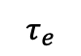
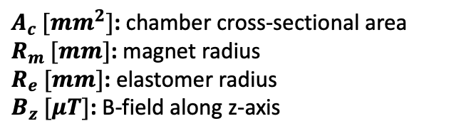
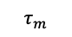
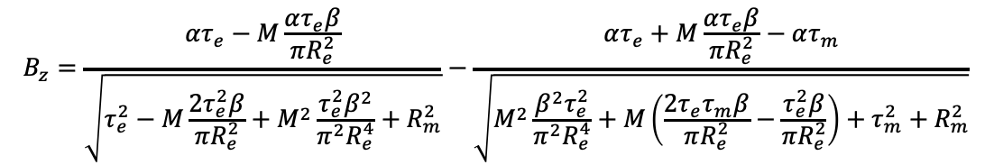
Static Water Derivation
Elastomer Equation
$$z=τ_{e}\left(1−\frac{βM}{πR_{e}^{2}}\right)−τ_{m}$$
$$R_{m}$$
$$τ_{m}$$
Magnet
Magnet Equation
$$B_{z}=α\left(\frac{z+τ_{m}}{\sqrt{{\left(z+τ_{m}\right)}^{2}+R_{m}^{2}}}−\frac{z}{\sqrt{z^{2}+R_{m}^{2}}}\right)$$
$$R_{e}$$
$$τ_{e}$$
$$M$$
Elastomer
The objective is to solve for the mass $M$ from the B-field $B_{z}$, so combining the two equations yields:
$$z$$
$$B_{z}=\frac{ατ_{e}−M\frac{ατ_{e}β}{πR_{e}^{2}}}{\sqrt{τ_{e}^{2}−M\frac{2τ_{e}^{2}β}{πR_{e}^{2}}+M^{2}\frac{τ_{e}^{2}β^{2}}{π^{2}R_{e}^{4}}+R_{m}^{2}}}−\frac{ατ_{e}+M\frac{ατ_{e}β}{πR_{e}^{2}}−ατ_{m}}{\sqrt{M^{2}\frac{β^{2}τ_{e}^{2}}{π^{2}R_{e}^{4}}+M\left(\frac{2τ_{e}τ_{m}β}{πR_{e}^{2}}−\frac{τ_{e}^{2}β}{πR_{e}^{2}}\right)+τ_{m}^{2}+R_{m}^{2}}}$$
Container
Sensor
Variables
$A_{c} [mm^{2}]$: chamber cross-sectional area
$R_{m} [mm]$: magnet radius
$R_{e} [mm]$: elastomer radius
$B_{z} [μT]$: B-field along z-axis
$τ_{m} [mm]$: magnet thickness
$τ_{e} [mm]$: elastomer thickness
$z [mm]$: magnet distance from magnetometer sensor
$M [g]$: mass of fluid
$α,β$: fitting parameters (physical properties of apparatus)

Slide 21
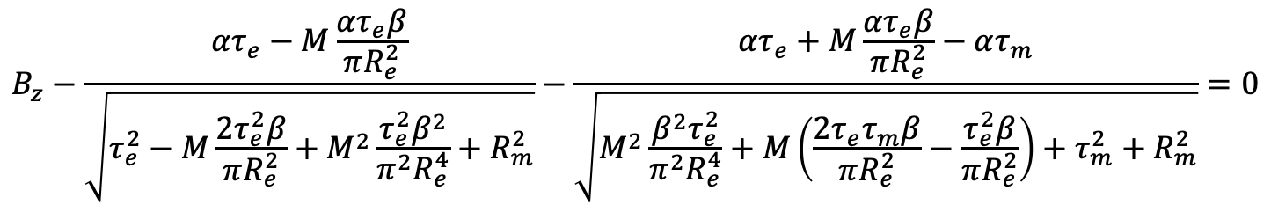
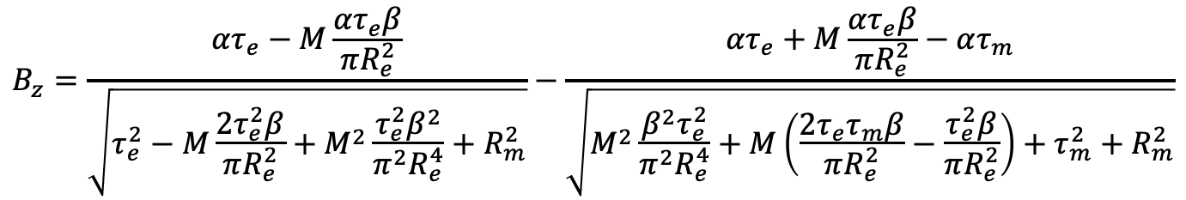
Static Water Derivation
Continuing from the previous step, to solve for the mass from the B-field value, numerical methods must be used since the mass is not easily algebraically separable in the below equation:
$$B_{z}=\frac{ατ_{e}−M\frac{ατ_{e}β}{πR_{e}^{2}}}{\sqrt{τ_{e}^{2}−M\frac{2τ_{e}^{2}β}{πR_{e}^{2}}+M^{2}\frac{τ_{e}^{2}β^{2}}{π^{2}R_{e}^{4}}+R_{m}^{2}}}−\frac{ατ_{e}+M\frac{ατ_{e}β}{πR_{e}^{2}}−ατ_{m}}{\sqrt{M^{2}\frac{β^{2}τ_{e}^{2}}{π^{2}R_{e}^{4}}+M\left(\frac{2τ_{e}τ_{m}β}{πR_{e}^{2}}−\frac{τ_{e}^{2}β}{πR_{e}^{2}}\right)+τ_{m}^{2}+R_{m}^{2}}}$$
To accomplish this, the equation is rearranged into the form of a root-finding problem:
$$B_{z}−\frac{ατ_{e}−M\frac{ατ_{e}β}{πR_{e}^{2}}}{\sqrt{τ_{e}^{2}−M\frac{2τ_{e}^{2}β}{πR_{e}^{2}}+M^{2}\frac{τ_{e}^{2}β^{2}}{π^{2}R_{e}^{4}}+R_{m}^{2}}}−\frac{ατ_{e}+M\frac{ατ_{e}β}{πR_{e}^{2}}−ατ_{m}}{\sqrt{M^{2}\frac{β^{2}τ_{e}^{2}}{π^{2}R_{e}^{4}}+M\left(\frac{2τ_{e}τ_{m}β}{πR_{e}^{2}}−\frac{τ_{e}^{2}β}{πR_{e}^{2}}\right)+τ_{m}^{2}+R_{m}^{2}}}=0$$

Slide 22
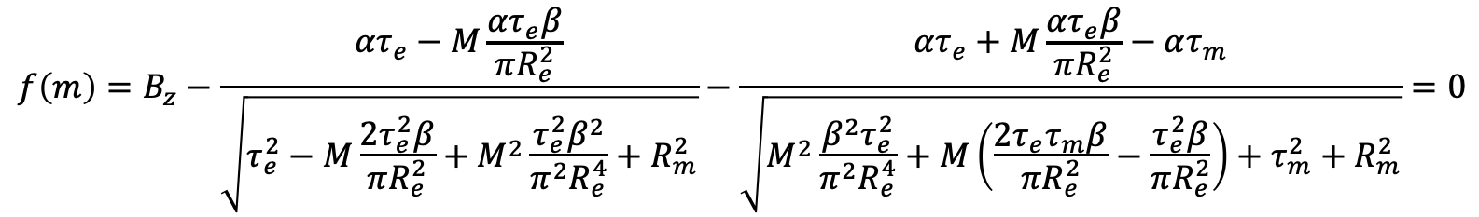
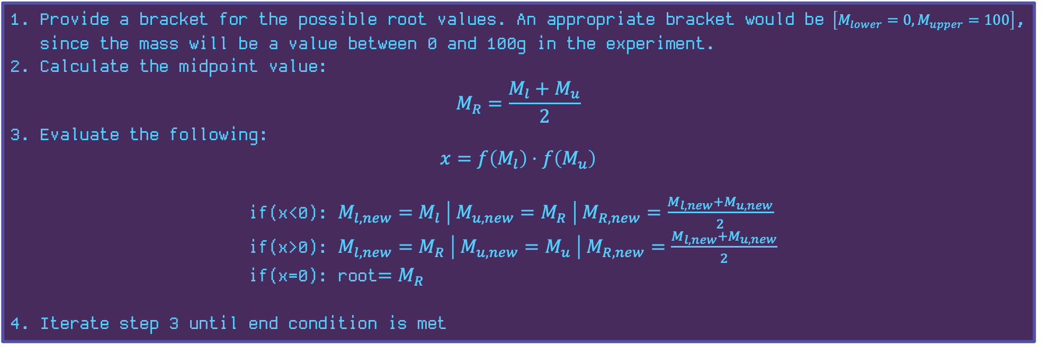
Static Water Derivation
$$f\left(m\right)=B_{z}−\frac{ατ_{e}−M\frac{ατ_{e}β}{πR_{e}^{2}}}{\sqrt{τ_{e}^{2}−M\frac{2τ_{e}^{2}β}{πR_{e}^{2}}+M^{2}\frac{τ_{e}^{2}β^{2}}{π^{2}R_{e}^{4}}+R_{m}^{2}}}−\frac{ατ_{e}+M\frac{ατ_{e}β}{πR_{e}^{2}}−ατ_{m}}{\sqrt{M^{2}\frac{β^{2}τ_{e}^{2}}{π^{2}R_{e}^{4}}+M\left(\frac{2τ_{e}τ_{m}β}{πR_{e}^{2}}−\frac{τ_{e}^{2}β}{πR_{e}^{2}}\right)+τ_{m}^{2}+R_{m}^{2}}}=0$$
The bisection method is used to solve for the mass $M$using the following algorithm:
Provide a bracket for the possible root values. An appropriate bracket would be $\left[M_{lower}=0, M_{upper}=100\right]$, since the mass will be a value between 0 and 100g in the experiment.
Calculate the midpoint value:
$$M_{R}=\frac{M_{l}+M_{u}}{2}$$
Evaluate the following:
$$x=f\left(M_{l}\right)⋅f\left(M_{u}\right)$$
if(x<0): $M_{l,new}=M_{l} \left| M_{u,new}=M_{R} \right| M_{R,new}=\frac{M_{l,new}+M_{u,new}}{2}$
if(x>0): $M_{l,new}=M_{R} \left| M_{u,new}=M_{u} \right| M_{R,new}=\frac{M_{l,new}+M_{u,new}}{2}$
if(x=0): root$=M_{R}$
Iterate step 3 until end condition is met

Slide 23
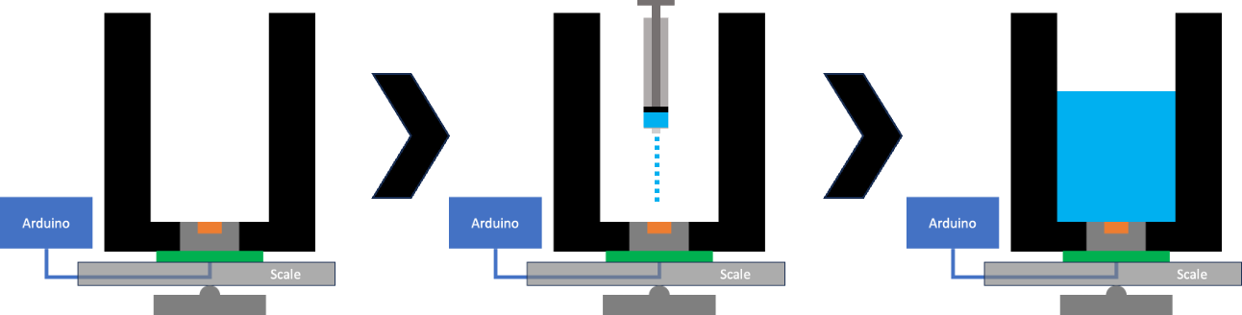
Static Water Calibration Procedure V1
Record a magnetometer reading when the container is empty of water
Measure out 2 mL of water using syringe and inject onto the elastomer
Press the button to record the magnetometer measurement of the B-field value
Manually record the mass of the water as shown by the digital scale
Repeat this until 125 mL of water has been added
Key
Container
Elastomer
Magnet
PCB

Slide 24
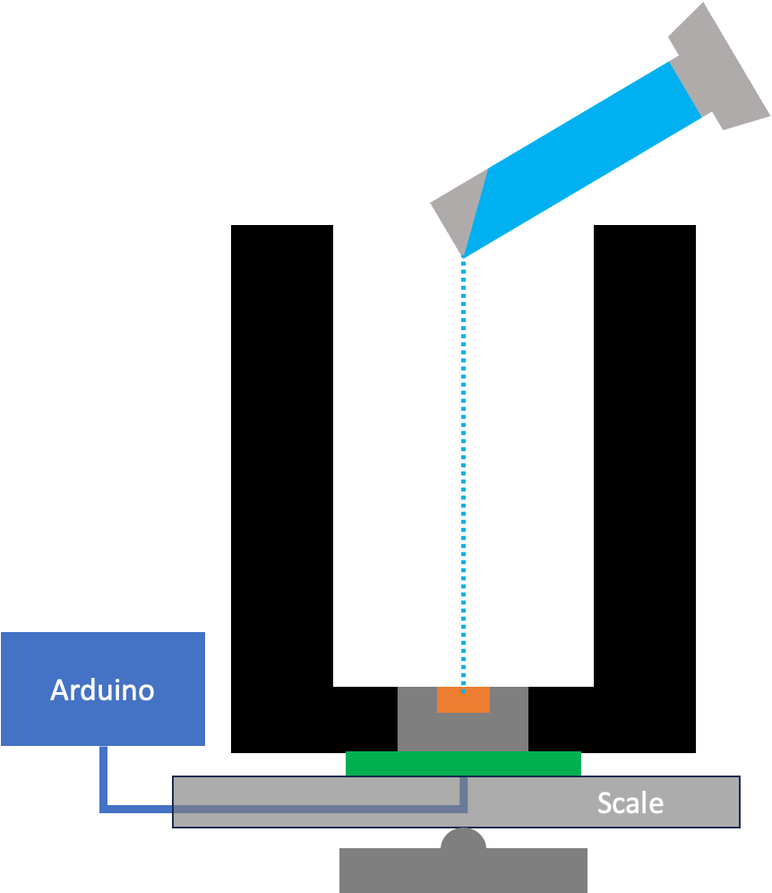
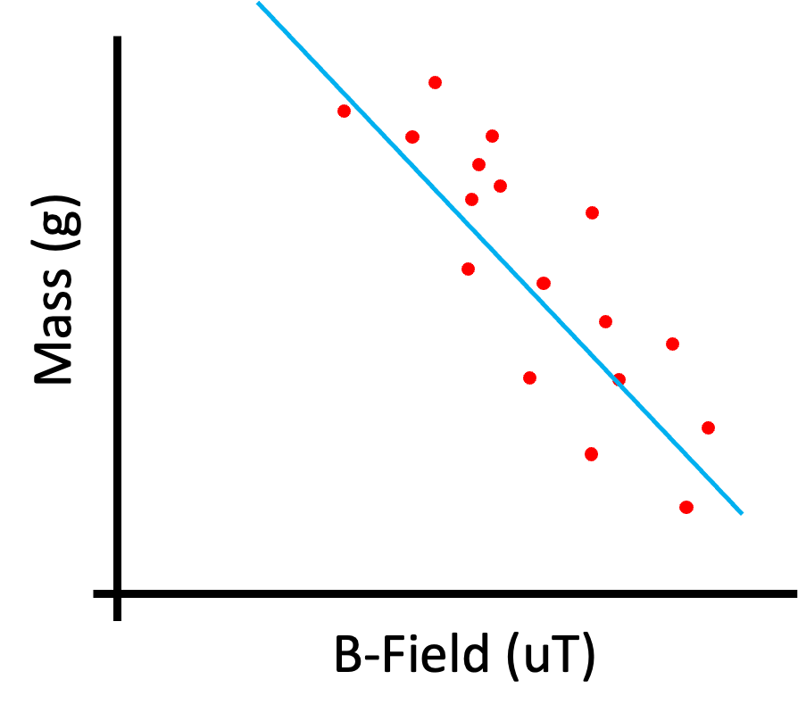
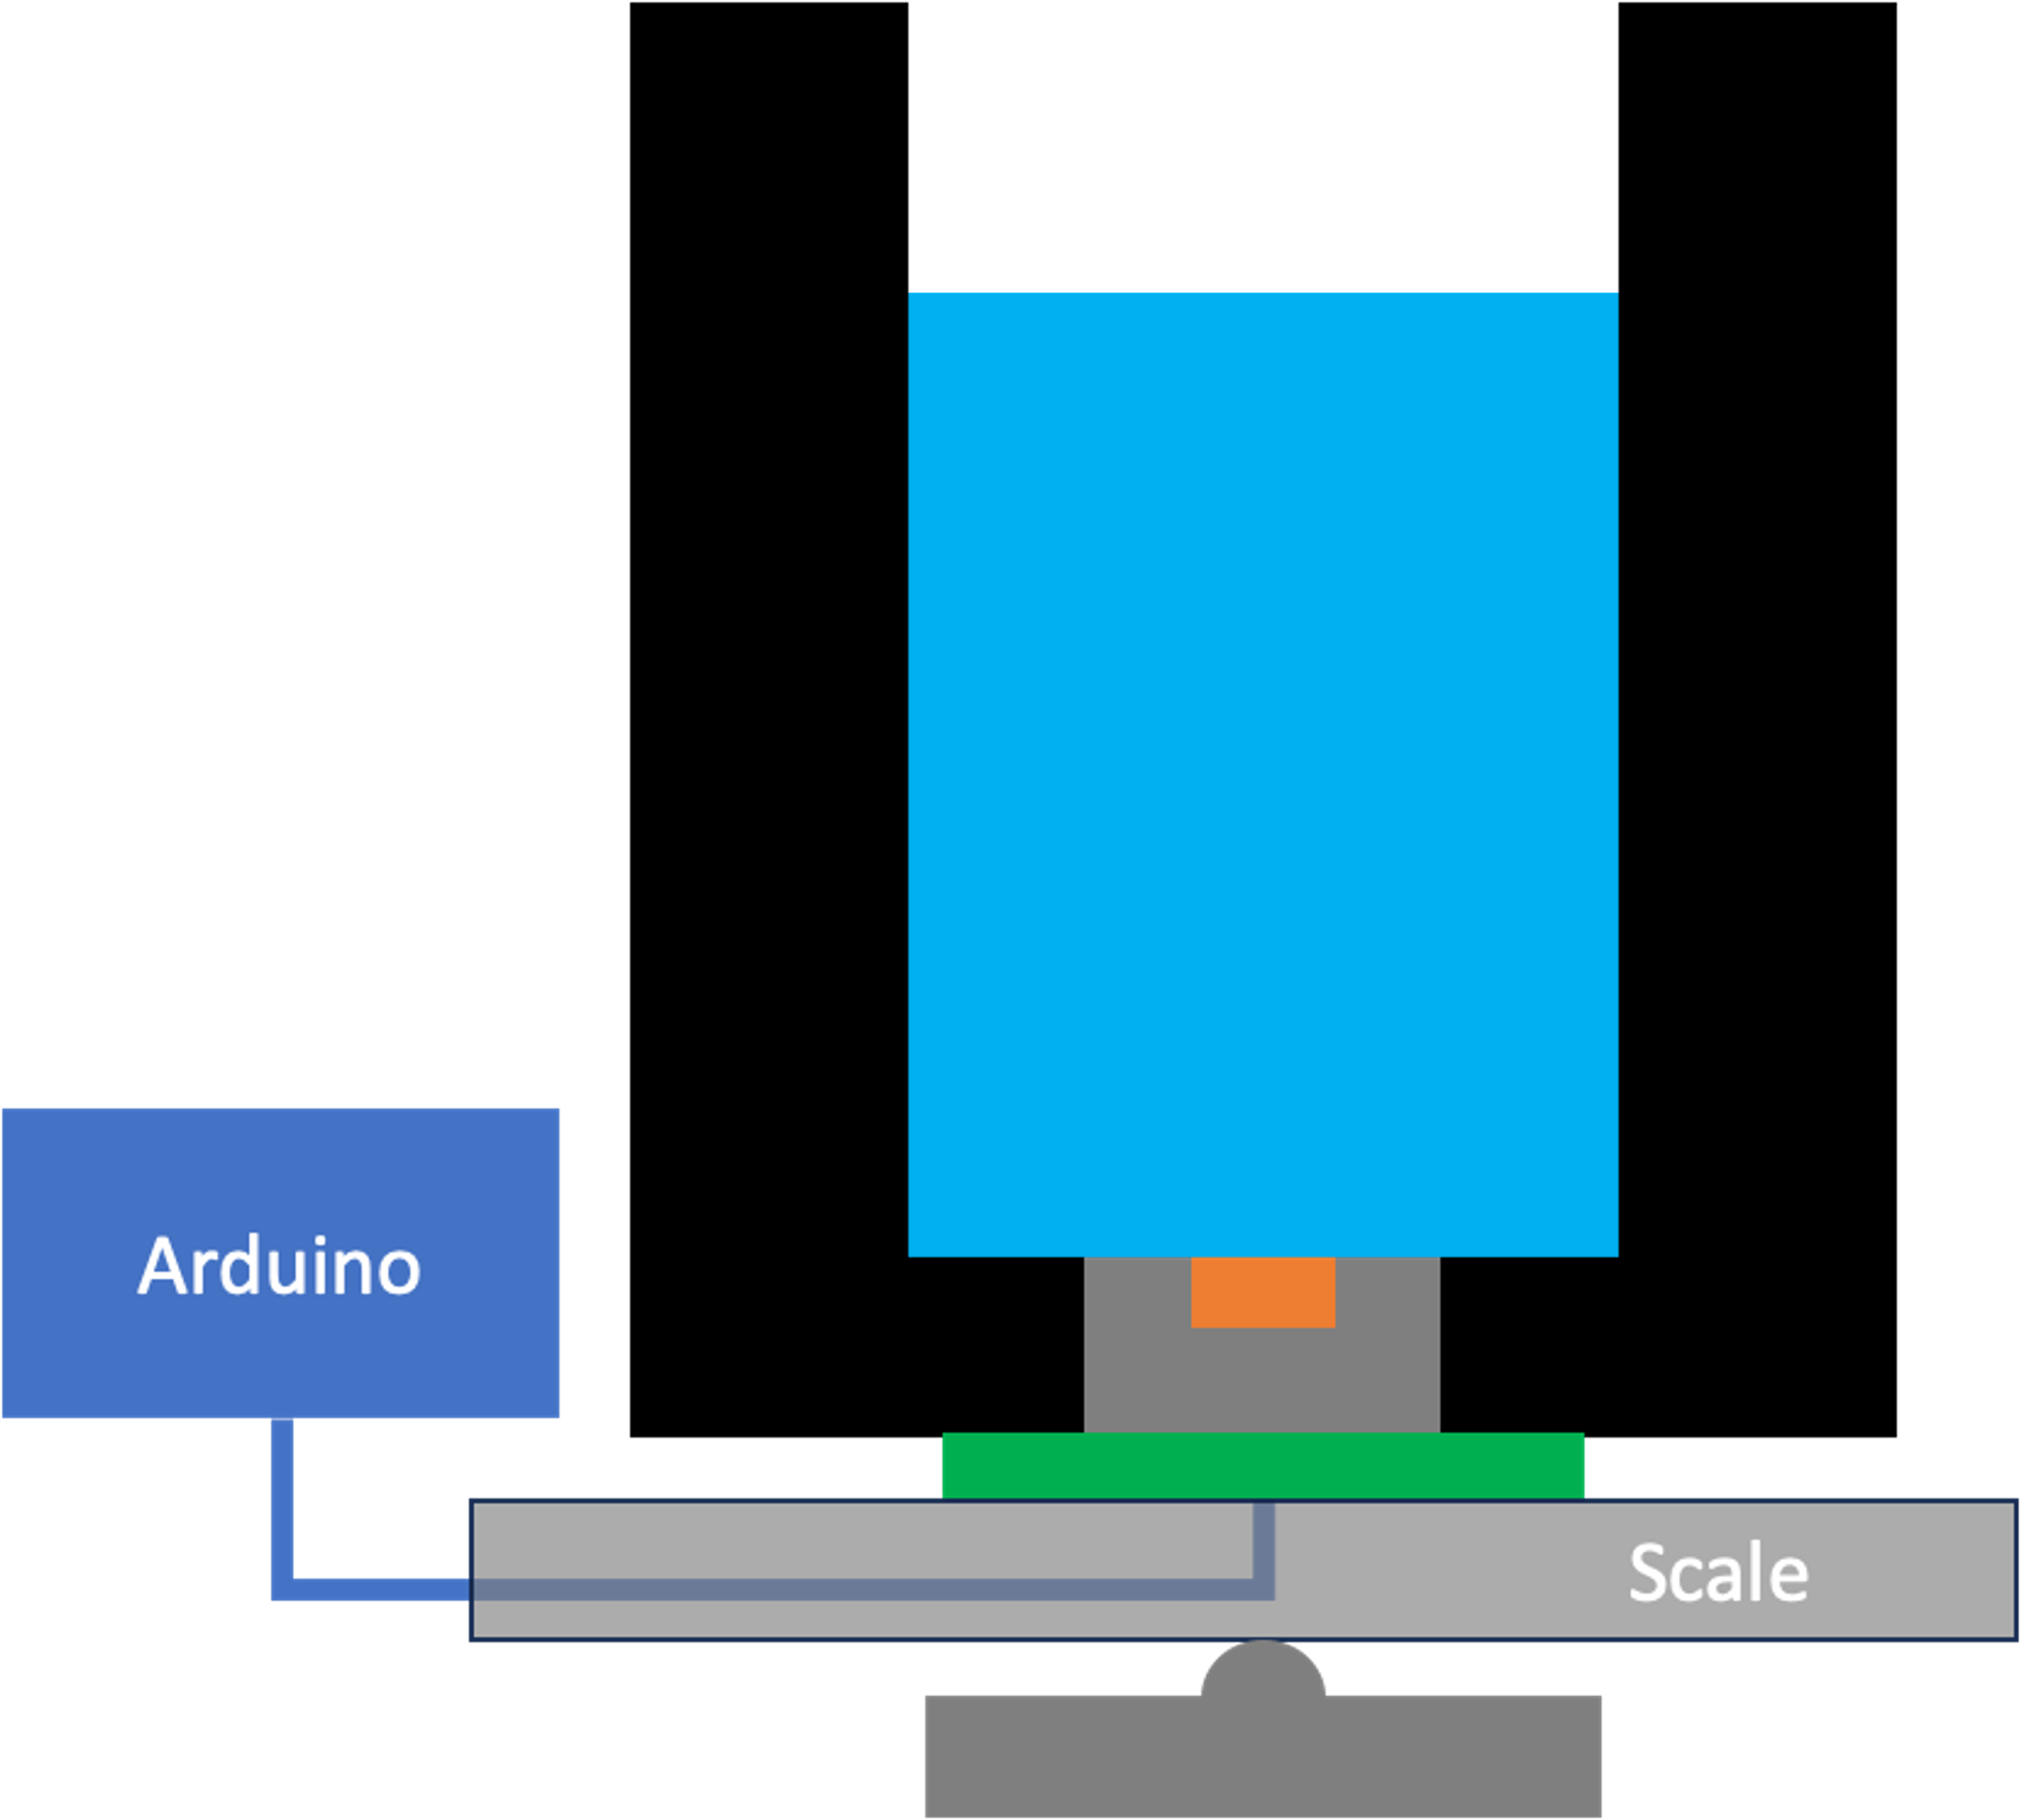
Static Water Test Procedure V1
Measure out 100 mL of water using the graduated cylinder
Inject the water onto the elastomer
Record the measured B-field value
Using the linear regression line of best fit from the calibration, calculate the predicted water mass from the B-field value
Repeat this for 6 trials and compare to true value of 100 g
Key
Container
Elastomer
Magnet
PCB

Slide 25
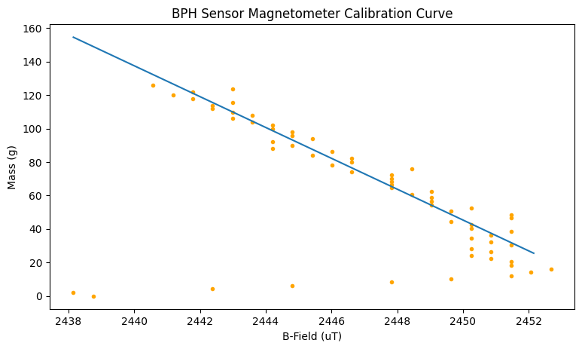
Static Water Experiment Data
Calibration Results
Test Results
Average | 104 g
Standard Deviation | 12.7 g
Accuracy | 95.9 %

Slide 26
Discussion
Notice the inconsistency with the low mass values (< 20 g). I realized that this was at approximately the mass of water required to completely cover the elastomer sensor. After this critical mass, the measurements are more accurate.

Slide 27
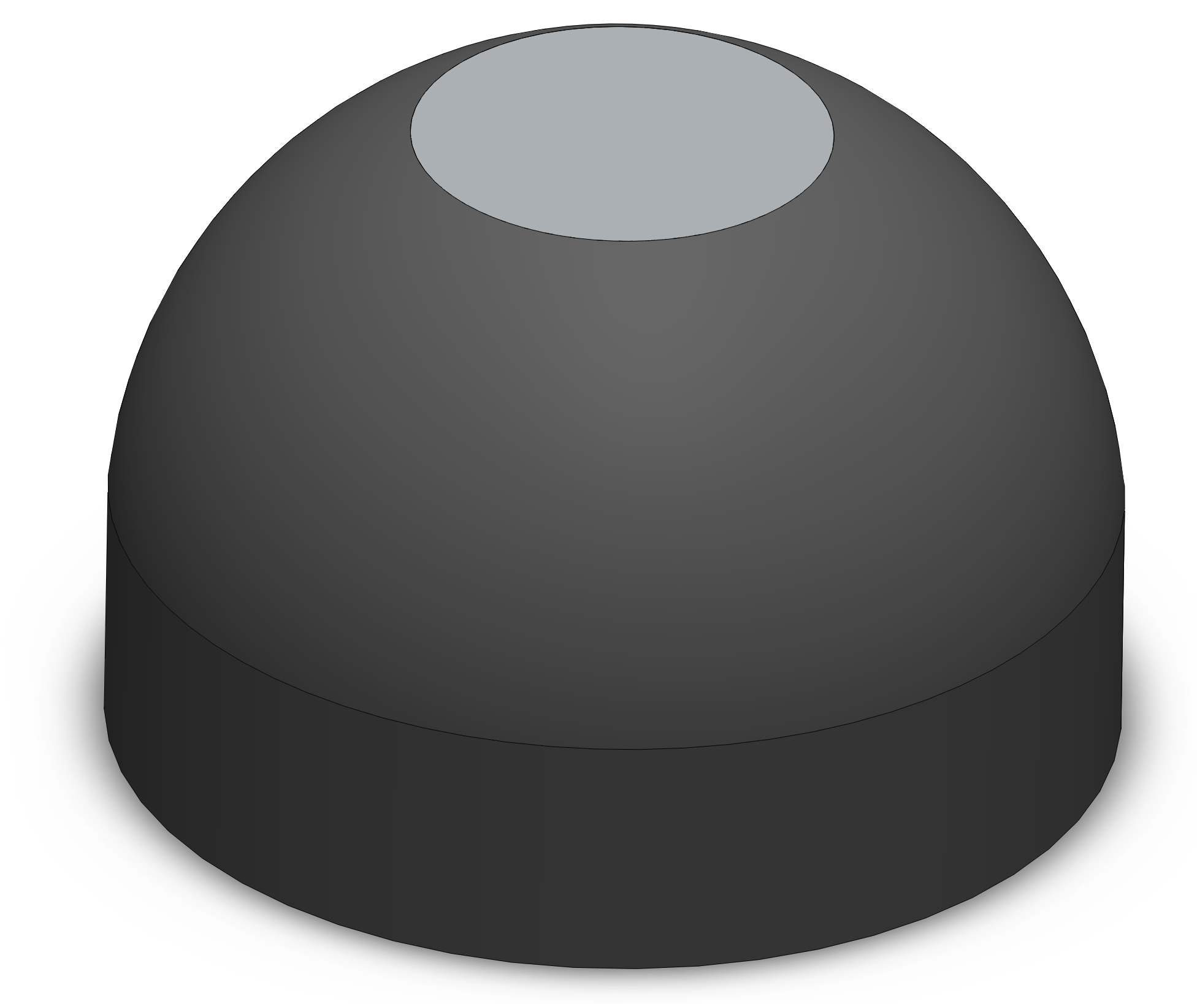
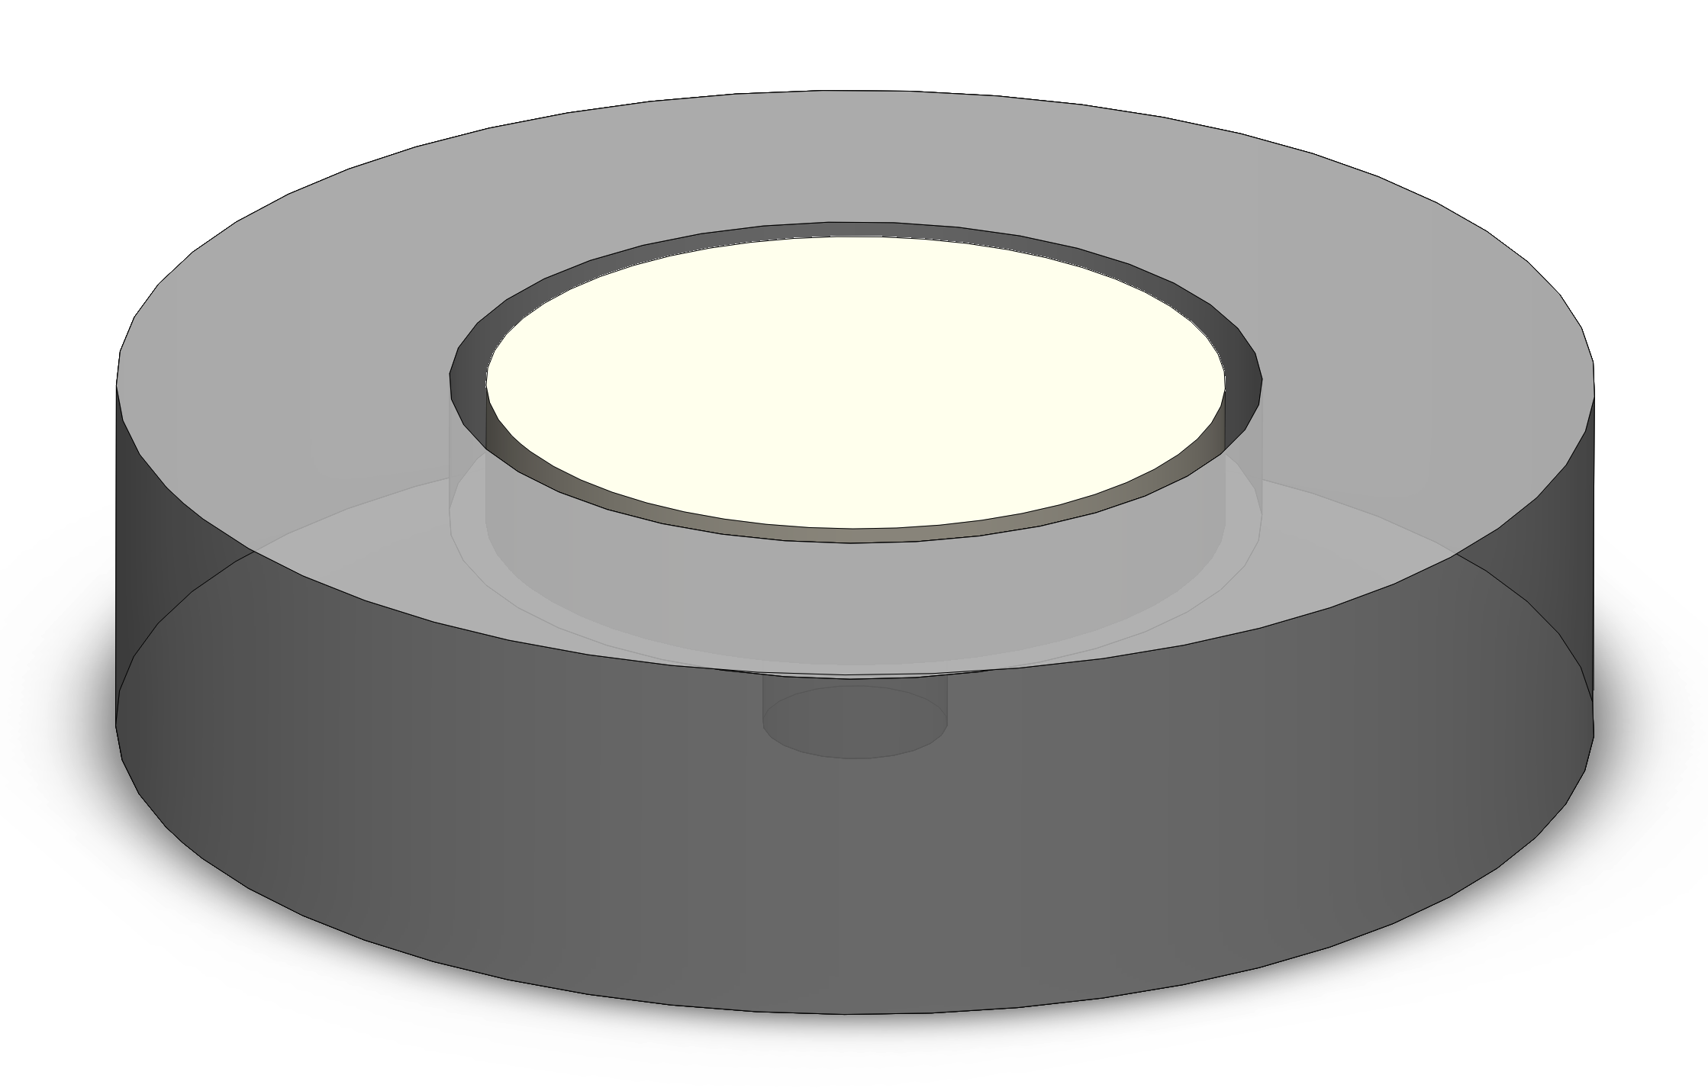
Discussion
To solve this, I redesigned the elastomer geometry to be flush with the surface of the container.
V1
V2

Slide 28
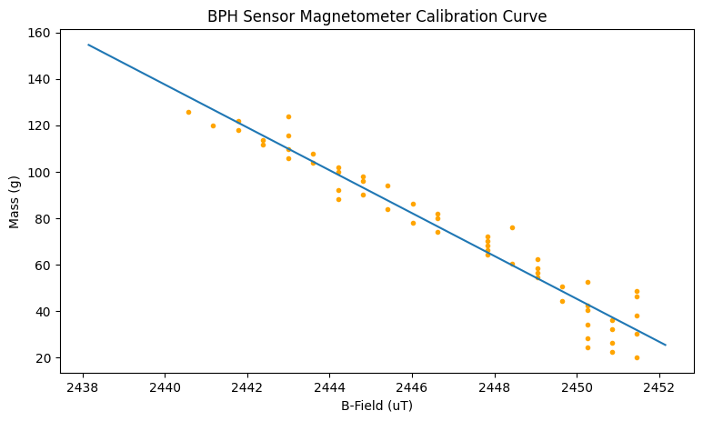
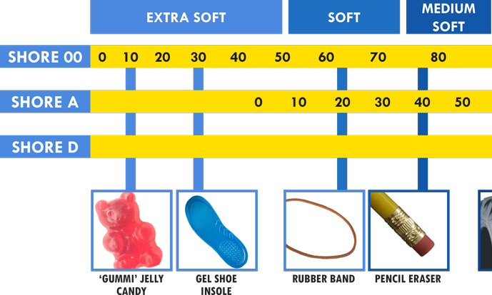
Discussion
Furthermore, the sensor reads the same B-field value for different masses. This indicates the current configuration is not sensitive enough to differentiate between these changes or the environmental B-field is non-negligible relative to the magnet B-field. To fix this, I am using larger magnets (from 5 mm to 10 mm) and softer silicones (from Shore 20A to Shore 00-50).

Slide 29
Static Water Calibration Procedure V2
Calibrate the load cell with the 10g lead weight
The circuit will begin recording both, the mass and the B-field automatically
Add 2 mL of water after ~150 readings at the previous mass
Repeat this until 100 mL of water has been added
Key
Container
Elastomer
Magnet
PCB

Slide 30
Static Water Test Procedure V2
Measure out 100 mL of water using the graduated cylinder
Inject the water onto the elastomer
Record the measured B-field value
Using the polynomial fit from the calibration, calculate the predicted water mass from the B-field value
Repeat this for 6 trials and compare to true value of 100 g
Key
Container
Elastomer
Magnet
PCB

Slide 31
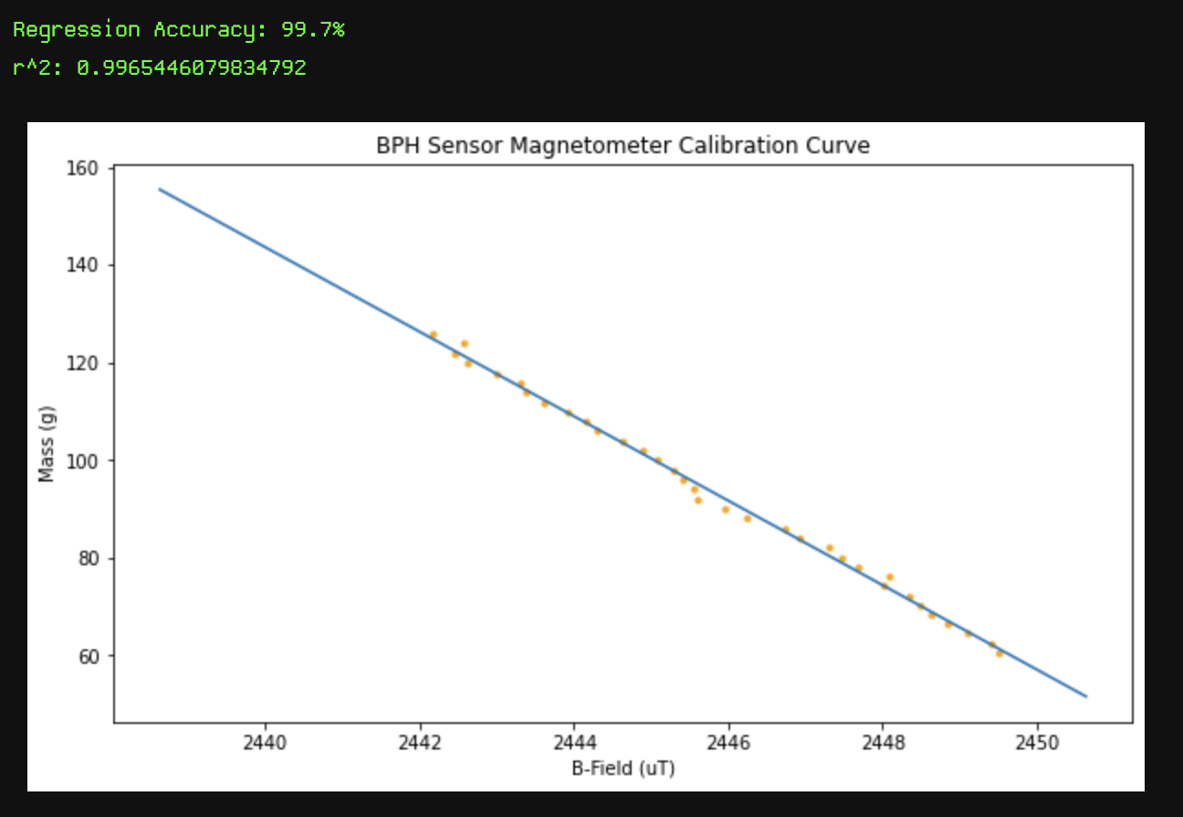
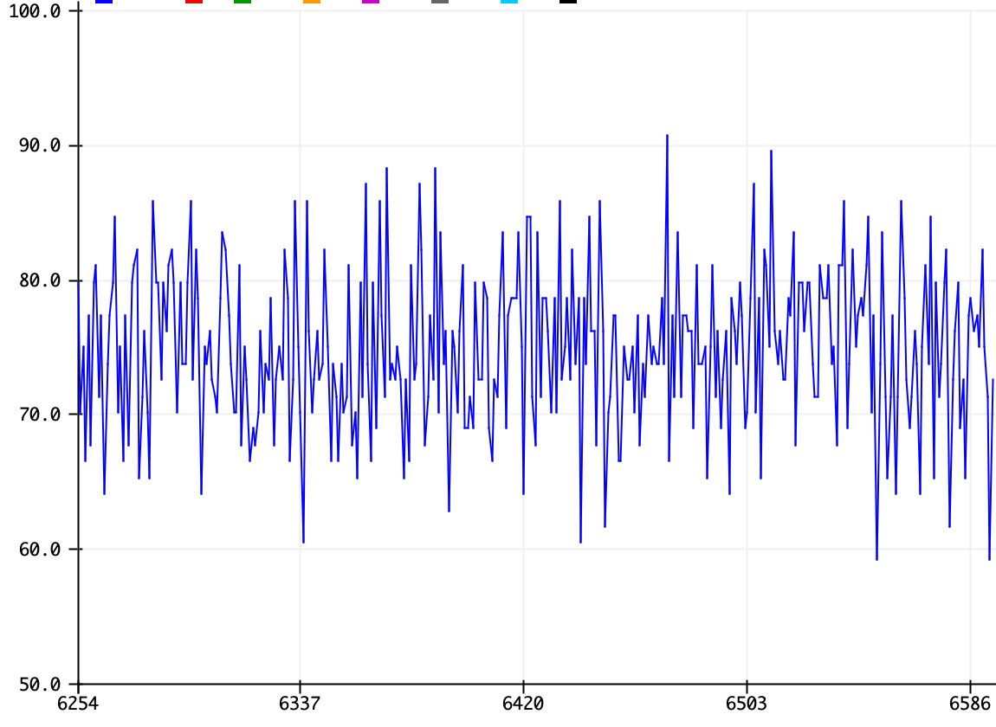
Discussion
While debugging to find the weak points of the design, I noticed that the sensor readings oscillate as shown below. The previous procedure did not account for this oscillation. To address this issue, I implemented a digital filter algorithm (exponential moving average), which increased the r² value to ~0.997.
Cleaned Data
Oscillating Data

Slide 32
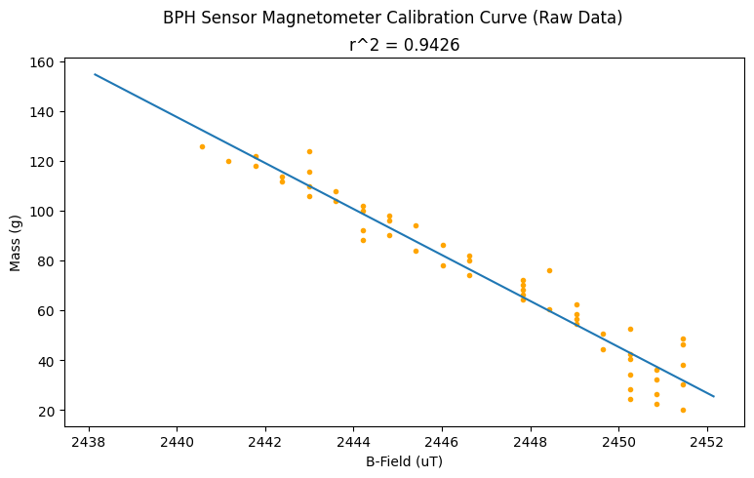
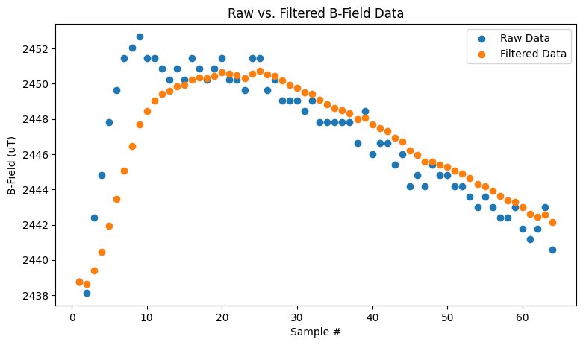
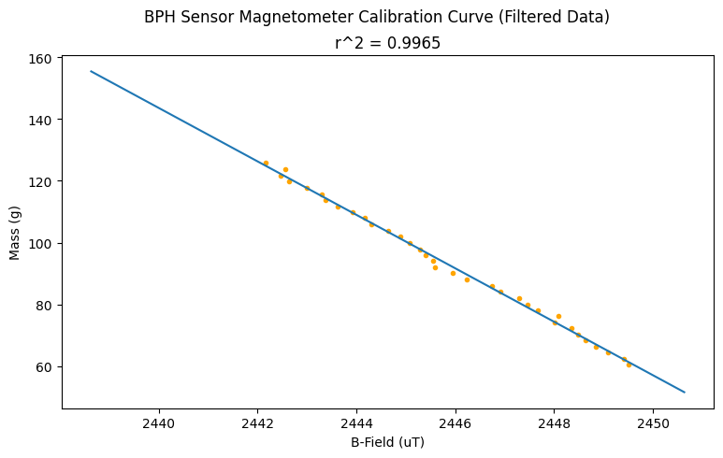
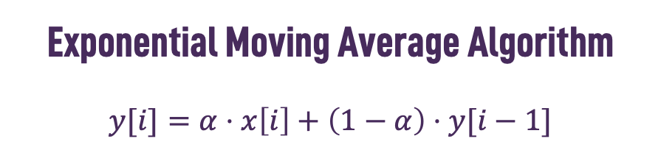
Exponential Moving Average Algorithm
$$y[i]=α⋅x\left[i\right]+\left(1−α\right)⋅y[i−1]$$
Filter

Slide 33




Slide 34
Problems
After conducting more rigorous tests, I found that this high correlation is attributed to the drift, not the actual mass reading.
False Negative Test – Did not add any water, but results show a large drift
Reverse Test – Started with 100g of water and started removing mass, but curve was still the same
Long Term False Negative Test – Same as #1, except I ran the experiment for an entire day (over 1.1 million data points). Curve displays low frequency sinusoidal noise
Ground Test – Measured magnetometer readings without including the elastomer

Slide 35


False Negative Test Results

Slide 36


Reverse Test Results

Slide 37


Long Term False Negative Test Results

Slide 38

Ground Test Results

Slide 39


Long Term Ground Test Results

Slide 40
Discussion
A few noteworthy observations I made from this data are:
The drift is clearly a sinusoidal noise. The source is still to be determined.
The magnetometer and the load cell drift in the same direction and at the same pace. I hypothesize that this can be addressed using the following:
The power from the Arduino might not be stable enough for the sensors. To verify this, redo the tests with a PSU that is reliably steady
The wiring might not be stable. To address this, try getting a circuit board printed of my circuit, or try using shorter wires.
Use an oscilloscope to determine the noise frequency and develop a filter to remove the noise.
Make a case that covers the test apparatus to mitigate any environmental factors such as dust or wind.
The ground test does not exhibit the same noise as the other tests, indicating that the sensor itself is not faulty.

Slide 41


Live Demo Test (Last Day Showcase)

Slide 42
Conclusions
The live demo test results are promising due to the following:
The b-field values are very clearly changing by a significant magnitude with each injection of a few milliliters of water. This shows that using the smaller magnet and ensuring the load of the water is all coming onto the elastomer
The curve appears steady, similar to the ground test data. However, further testing is required to confirm with longer experiments
It is important to note that the load cell was not calibrated properly during the live demo since I was only trying to show how the test setup works. With a proper test setup, I believe the system can achieve better results

Slide 43
Prototyping Phase 2
Dynamic Water Testing

Slide 44











Dynamic Water Derivation
$$Q_{in}$$
Base Equation
$$\frac{dV}{dt}=Q_{in}−Q_{out}$$
$$A_{c}$$
$$h$$
$$V$$
$$Q_{out}$$
The objective is to solve for the flow rate, which is $Q_{in}$, so rearranging gives the following:
$$Q_{in}=\frac{dV}{dt}+Q_{out}$$
$$A_{e}$$
Variables
$h [mm]$: height of fluid
$V [mL]$: volume of fluid
$A_{c} [mm^{2}]$: chamber cross-sectional area
$A_{e} [mm^{2}]$: exhaust cross-sectional area
$Q_{in} [mL/s]$: volumetric inflow rate of fluid
$Q_{out} [mL/s]$: volumetric outflow rate of fluid

Slide 45








Dynamic Water Derivation
$$Q_{in}=\frac{dV}{dt}+Q_{out}$$
$$Q_{in}$$
These following physical relationships are important in order to get the equation in terms that can be measured by the sensor:
$$Q_{out}=v_{e}A_{e}$$
$$v_{e}=C_{d}\sqrt{2gh}$$
$$V=\frac{m}{ρ}$$
$$\frac{dV}{dt}=\lim_{Δt→0}{\frac{V\left(t+Δt\right)−V(t)}{Δt}}$$
$v_{e} [m/s]$: Exhaust velocity of fluid
$C_{d} [unitless]$: Coefficient of discharge of fluid (experimentally determined)
$g [m/s^{2}]$: Gravitational acceleration
$m [g]$: Mass of fluid
$ρ [g/mL]$: Density of fluid
$$A_{c}$$
$$h$$
$$V$$
$$Q_{out}$$
$$A_{e}$$

Slide 46


Dynamic Water Derivation
$$Q_{in}$$
$$A_{c}$$
$$Q_{in}=\frac{dV}{dt}+Q_{out}$$
Using the previous definitions, the equation can be rewritten as:
$$Q_{in}=\frac{1}{ρ}\lim_{Δt→0}{\frac{m\left(t+Δt\right)−m(t)}{Δt}}+A_{e}C_{d}\sqrt{2gh}$$
Now this equation is in terms of variables that can be measured by the magnetometer sensor.
$$h$$
$$V$$
$$Q_{out}$$
$$A_{e}$$

Slide 47


Dynamic Water Derivation
$$Q_{in}$$
$$Q_{in}=\frac{1}{ρ}\lim_{Δt→0}{\frac{m\left(t+Δt\right)−m(t)}{Δt}}+A_{e}C_{d}\sqrt{2gh}$$
$$A_{c}$$
The magnetometer sensor measures the B-field value $x$, which is then converted into mass using a calibrated 5th order polynomial regression:
$$m=f(x)$$
where $m$ is mass in grams, $x$ is the B-field in µT, and $f$ is the polynomial evaluation
The height of fluid $h$ therefore can be computed using the following:
$$h=\frac{m}{ρA_{c}}=\frac{f(x) }{ρA_{c}}$$
To compute the derivative expressed above in the form of a limit, various numerical methods can be implemented. I have derived 6 different equations. Experimentation will help me determine which is the optimal equation.
$$h$$
$$V$$
$$Q_{out}$$
$$A_{e}$$

Slide 48



Numerical Methods
$$Q_{in}=\frac{dV}{dt}+Q_{out}=\frac{1}{ρ}\lim_{Δt→0}{\frac{m\left(t+Δt\right)−m(t)}{Δt}}+A_{e}C_{d}\sqrt{2gh}$$
Forward Finite Difference O(h)
$$Q_{in}=\frac{f\left(x_{i+1}\right)−f(x_{i})}{ρΔt}+A_{e}C_{d}\sqrt{2g\frac{f(x_{i+1})}{ρA_{c}}}$$
Forward Finite Difference O(h ²)
$$Q_{in}=\frac{4f\left(x_{i+1}\right)−f(x_{i+2})−3f(x_{i})}{2ρΔt}+A_{e}C_{d}\sqrt{2g\frac{f(x_{i+2})}{ρA_{c}}}$$
Backward Finite Difference O(h)
$$Q_{in}=\frac{f\left(x_{i}\right)−f(x_{i−1})}{ρΔt}+A_{e}C_{d}\sqrt{2g\frac{f(x_{i})}{ρA_{c}}}$$
Backward Finite Difference O(h ²)
$$Q_{in}=\frac{\left(3{f(x}_{i})−{4f(x}_{i−1})+f(x_{i−2})\right)}{2ρΔt}+A_{e}C_{d}\sqrt{2g\frac{f(x_{i})}{ρA_{c}}}$$
Centered Finite Difference O(h ²)
$$Q_{in}=\frac{f\left(x_{i+1}\right)−f(x_{i−1})}{2ρΔt}+A_{e}C_{d}\sqrt{2g\frac{f\left(x_{i+1}\right)}{ρA_{c}}}$$
Centered Finite Difference O(h ⁴)
$$Q_{in}=\frac{\left({f(x}_{i−2})+8f(x_{i+1})−8f(x_{i−1})−f(x_{i+2})\right)}{12ρΔt}+A_{e}C_{d}\sqrt{2g\frac{f\left(x_{i+2}\right)}{ρA_{c}}}$$
Notes:
Note: This is the derivation for if there is a linear fit between mass and B-field such that mass = alpha*B_field + beta. For more accurate results, use the magnet equation from the research paper on tri-axis force measurement using a magnetic elastomer sensor.

Slide 49
Future Steps
Solve the noise issues in the static water test in order to acquire accurate calibration curves and fit B-field values to mass values using polynomial regression
Once a decent polynomial model is generated, conduct dynamic water testing
Analyze dynamic water test results and iterate to fix any issues
Once desirable results are achieved, design a new fixture within the UrinDX device or design a new device to contain the magnetometer sensor system and elastomer
Conduct simulation testing using the newly designed system

